Slide 1
NASA eClips™ 4D Resources
Notes:
Joan

Slide 2
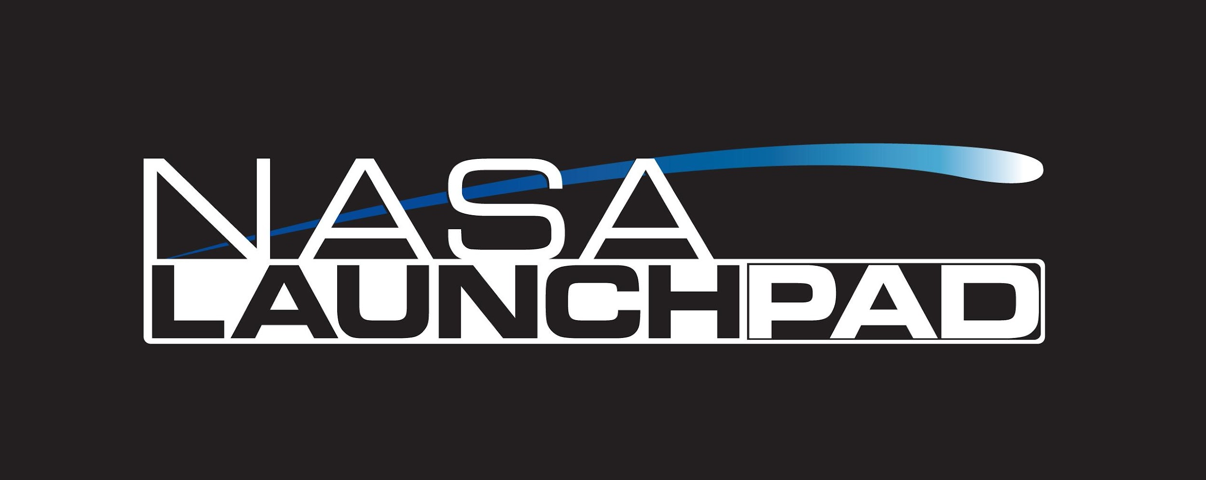
NASA eClips 4D Resources
Videos
Educator
Resources
Student-produced
Guides
Virtual Vocabulary
Engineering Packets
Professional
Full
Guide Lites
Elementary
Middle & High
Elementary
School
Middle School
High
School
Ask SME
Created by Middle and High School Students
V.A.L.U.E. Bundles
https://nasaeclips.arc.nasa.gov/
Notes:
NASA eClips™ was developed in 2008 to build a repository of educator resources that focused on science, technology, engineering, and mathematics through the lens of NASA. The National Institute of Aerospace worked with NASA to design short, educational video segments that would inspire students to learn about Earth science, the solar system (planetary science), the sun (heliophysics), and the universe (astrophysics). Through the study of these topics, students were introduced to a variety of subject matter experts (SMEs) and their careers as NASA scientists and engineers.
NASA eClips™ offer unlimited flexibility in the classroom for timing, sequencing and pacing instruction to meet the needs of students and classroom instructors. Educational material for this program is selected based on national curriculum standards identified by the Common Core State Standards - Mathematics (CCSS-M), the Next Generation Science Standards (NGSS), the Standards for Technological Literacy (defined by the International Technology Engineering Education Association (ITEEA), and the International Society for Technology in Education, or ISTE. For work with local educators, resources align and address Virginia SOLs.
NASA eClips™ is a NASA-supported project that brings together exciting video segments with educational best practices to inspire and educate students to become 21st Century explorers. This web-based video and resource repository for educators focuses on preparing students in grades 3 -12 for a world requiring a solid foundation in the sciences, technology, engineering, and mathematics (STEM). Engaging and interactive resources are available on-demand for easy integration into any lesson plan.

Slide 3
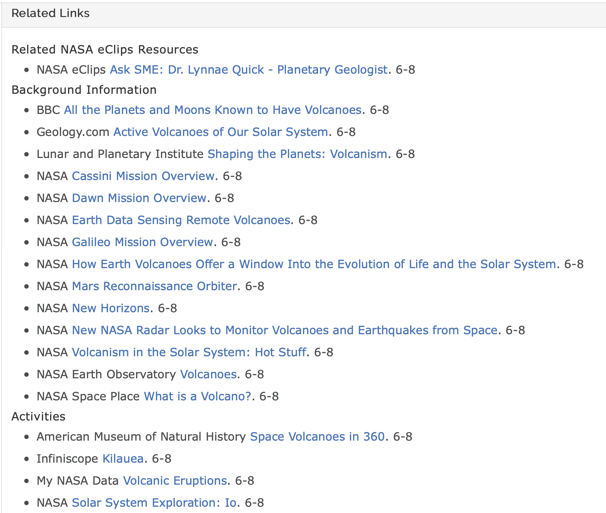
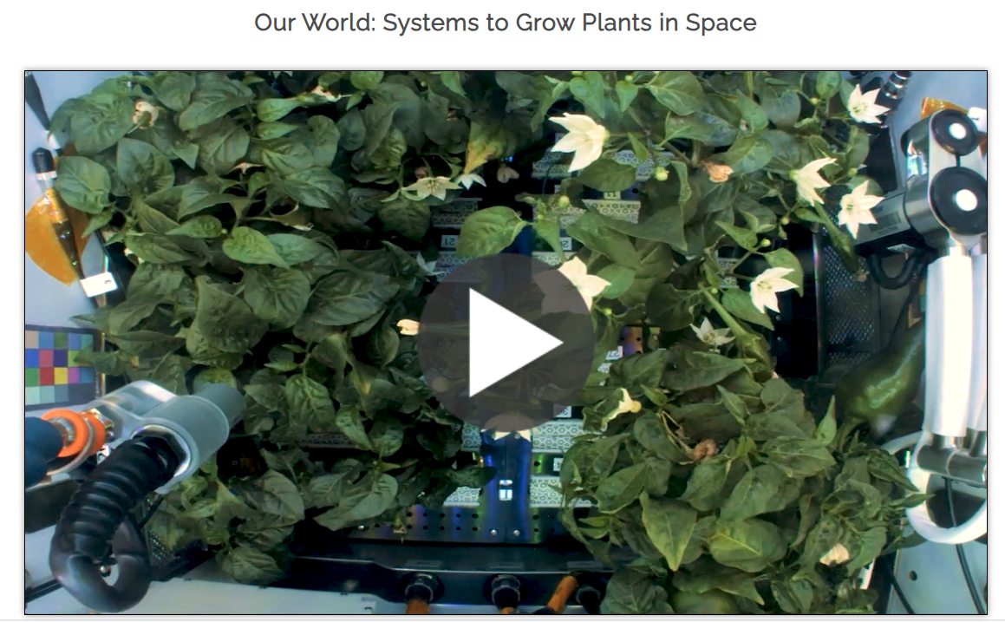
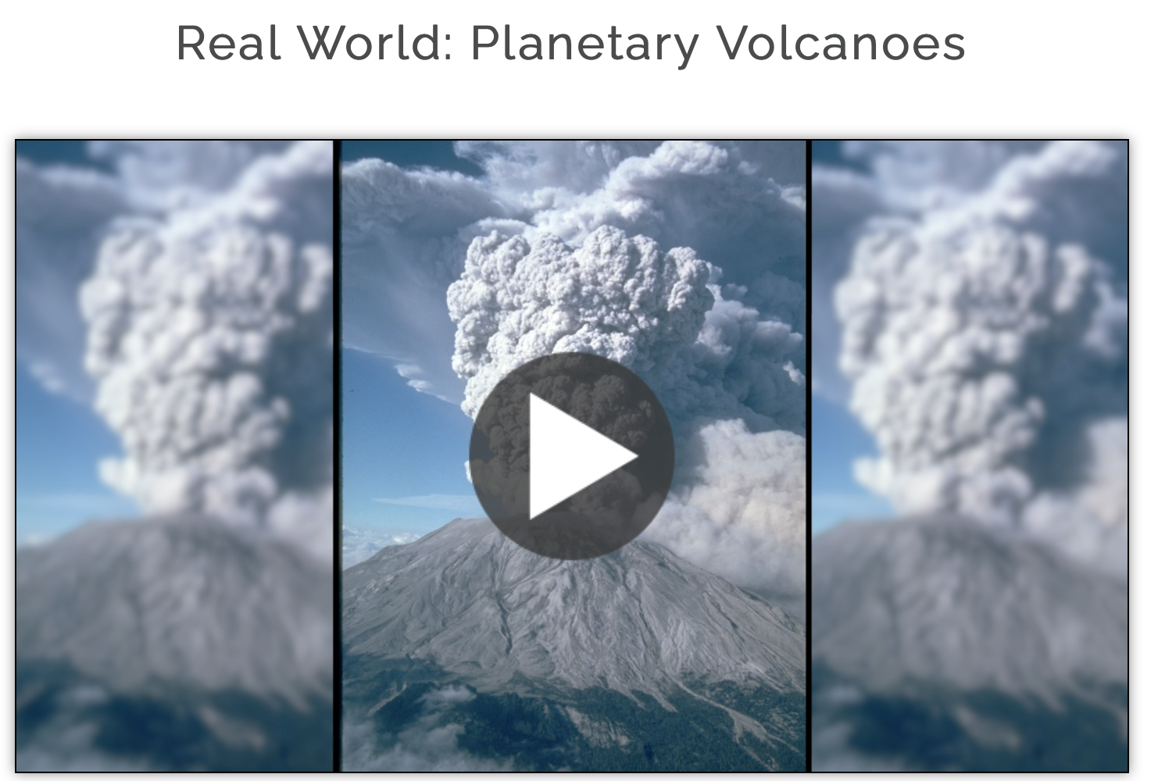
NASA eClips Videos
Notes:
NASA eClips™ resources support standards-based instruction by increasing STEM literacy in formal and nonformal settings. The free video segments inform and engage students, through NASA-inspired, real world connections.
Three NASA eClips™ programs are tailored to meet the needs of students in grades 3-12.
The NASA Our World videos (grades 3-5) help students understand the differences between science, the natural world, and engineering, the designed world. These video segments supplement elementary learning objectives not only in science, technology, engineering and mathematics, but can also be used to support oral and written communication through contextual vocabulary development.
NASA Real World segments (grades 6-8) connect classroom mathematics to 21st century careers and innovations and are designed to build a real-world, problem-solving context for mathematics.
NASA Launchpad videos focus on NASA innovations and the technology that take us into the future. These segments support project-based and problem-based learning experiences in science, mathematics, and career and technical education for students in grades 9-12.

Slide 4
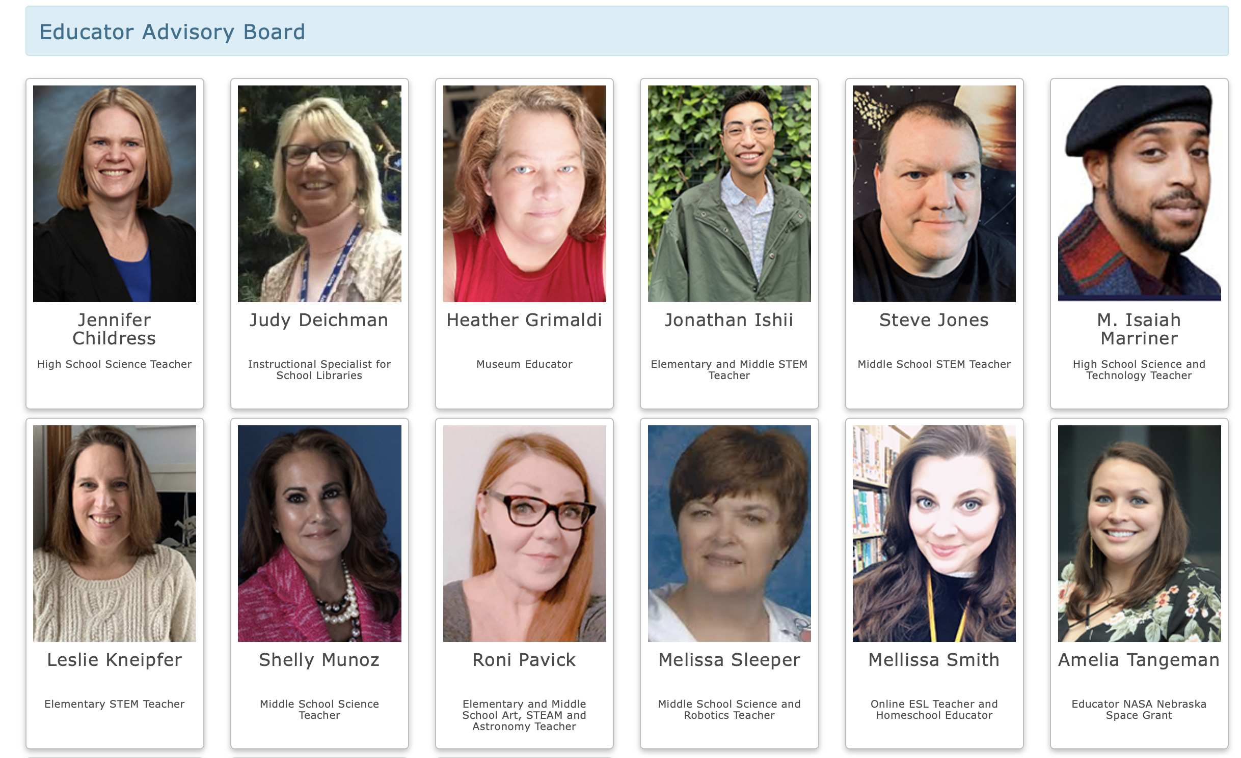
Intentional Design
Learners’ Needs & Interests
Educator Input
Research
Testing
Products and Resources
Notes:
Our products and resources are develop based on the end users' needs and interests. Our technical advisory board and educator advisory board play a key role in the process. The boards are involved in every step of the production process and each member provides a unique perspective based on their personal talents or skills. The learners they serve review videos and provide feedback prior to publishing.

Slide 5
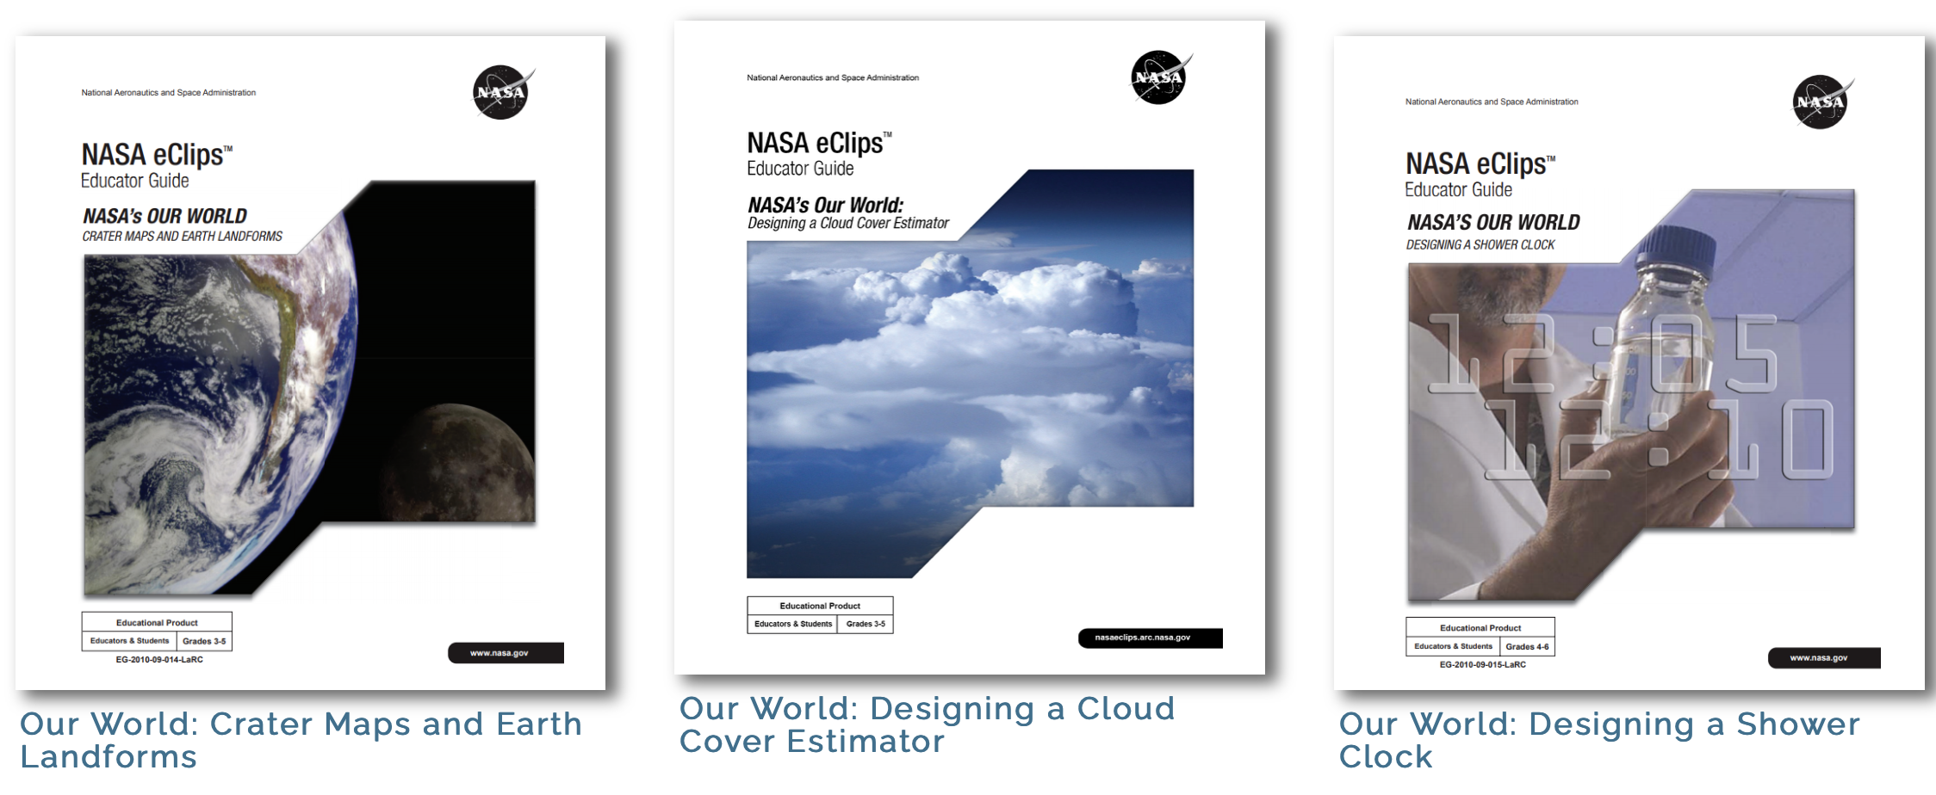
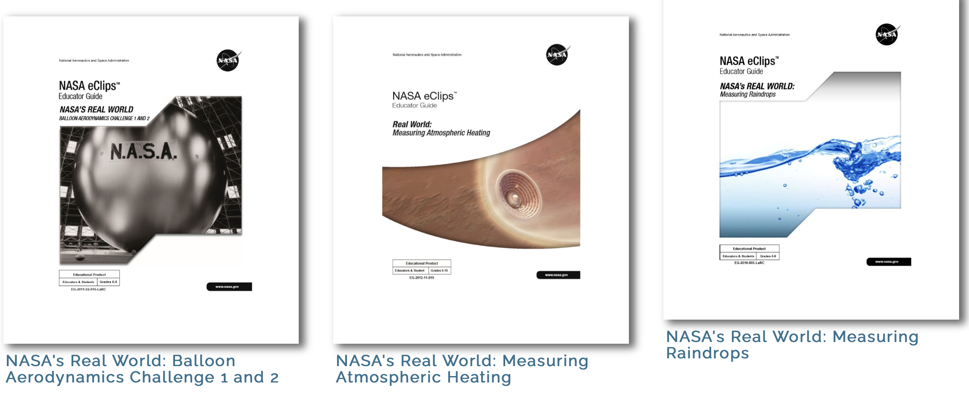
NASA eClips Educator Guides
Notes:
NASA eClips™ Educator Guides provide examples of ways teachers may effectively integrate the video segments into lesson plans using a 5E constructivist learning model. Each guide includes: instructional objectives, background information, instructions for implementing inquiry-based lessons, additional resources related to the topic and suggestions for extending or modifying lessons.
Guide Lites are streamlined activities for varying audiences.
Guide Lites that accompany NASA Spotlite videos, use the student-produced videos to build understanding of essential vocabulary through the collaborative use of Frayer Models. Other Guide Lites focus on activities pulled from Educator Guides and are well-suited for phenomenon-based science inquiry and/or non-formal educational settings. All Guide Lites are organized using the 5E learning model.
Design Packets guide students through a design process and may be used for any design-based project to enhance standards-based curriculum.

Slide 6
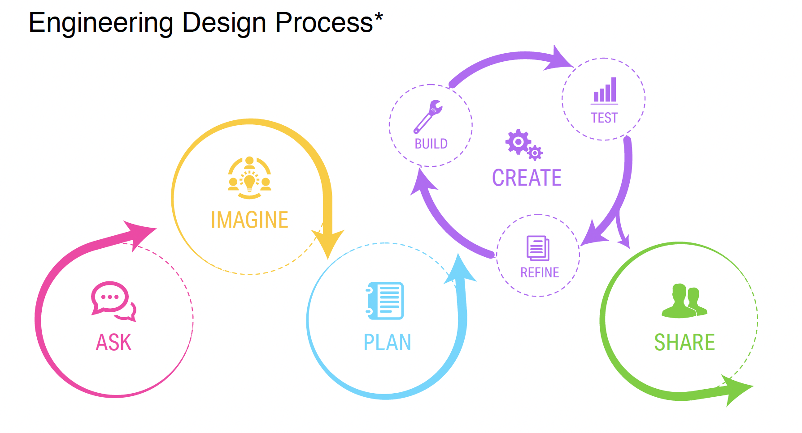
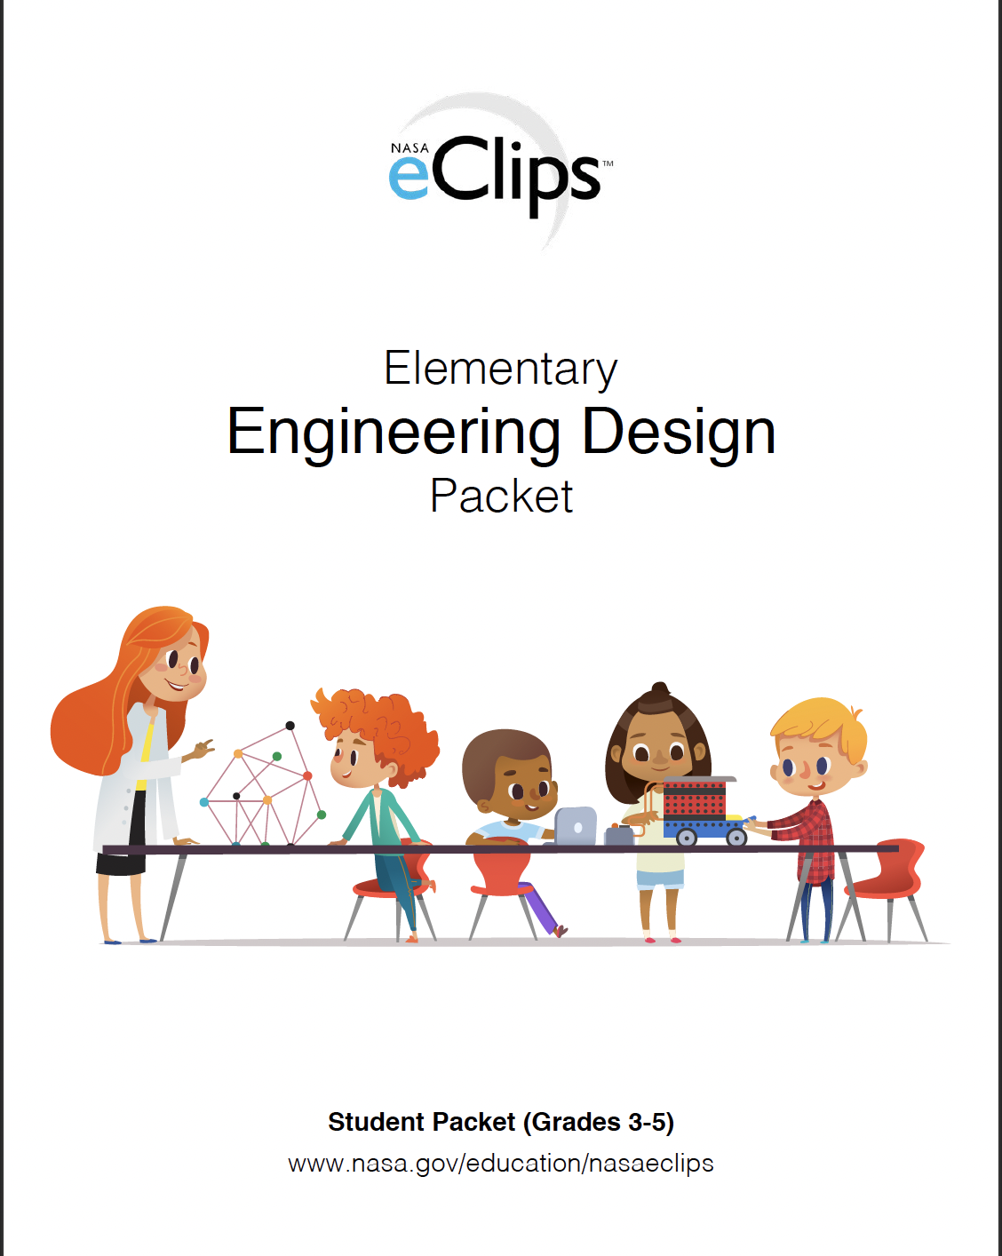
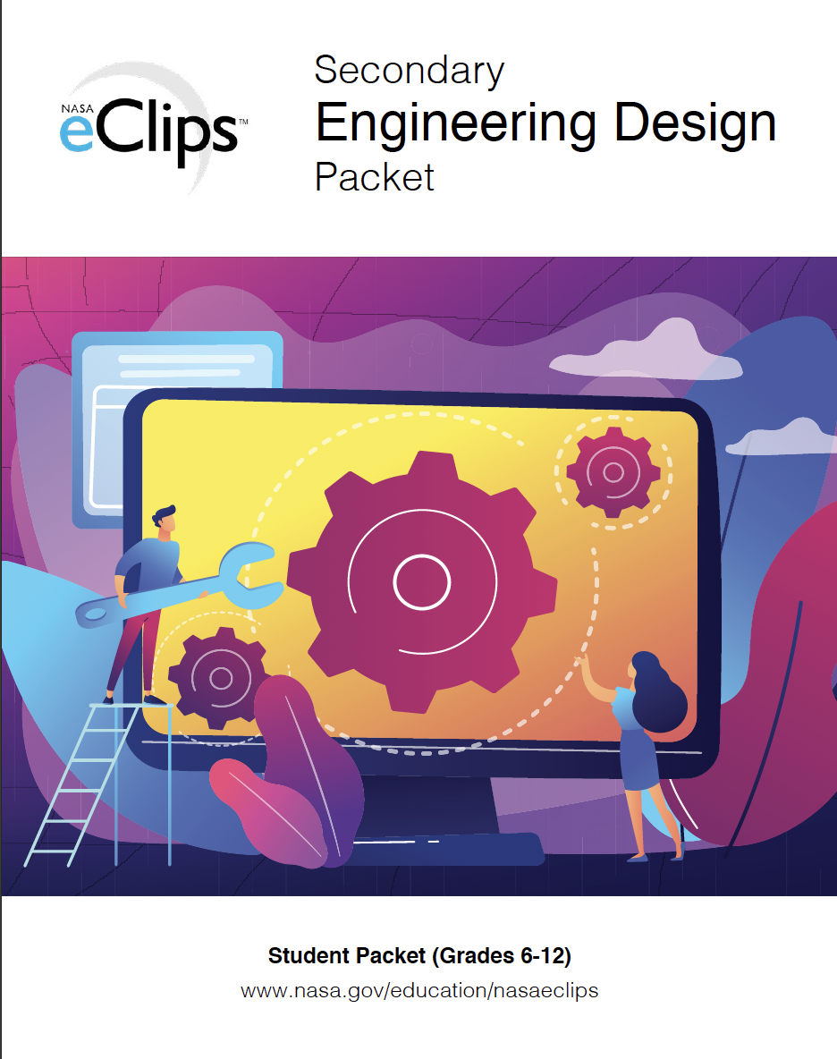
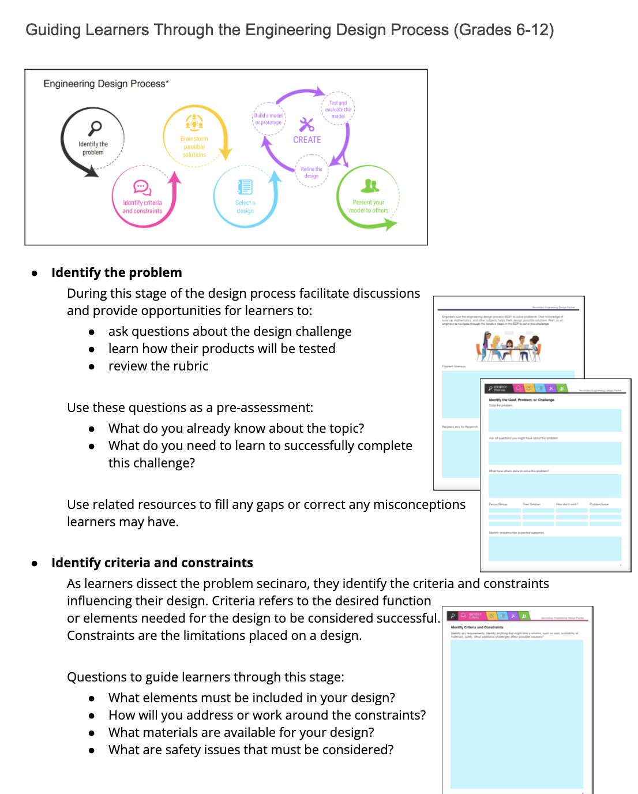
NASA eClips Educator Guides
Notes:
Revised Design Packets guide students through a design process and may be used for any design-based project to enhance standards-based curriculum.
Interactive features
Implementation guide
Multi formats

Slide 7
NASA Spotlite Lessons
Student-produced Videos Addressing Common Science Misconceptions Paired With Interactive Lessons Using The 5E Model
Notes:
NASA Spotlites are short (90-120 second) student-produced videos designed to debunk nationally recognized science misconceptions.
Teachers may use the Spotlites video design challenge to increase their students’ science literacy and communication skills. From research, to script, to screen, students build their own understanding of the science concept through creative video representations. This project may be used by digital media, science, and English teachers as an authentic, interdisciplinary task.

Slide 8
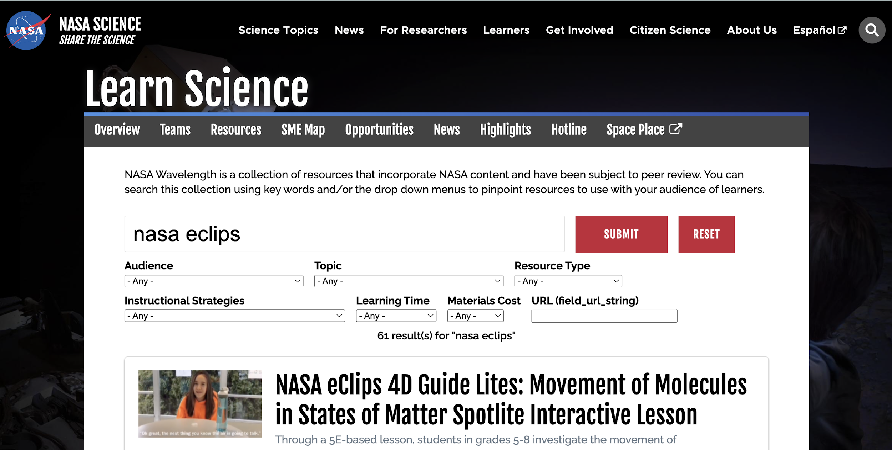
NASA Spotlite Lessons On Science.NASA.gov Nearpod.com

Slide 9
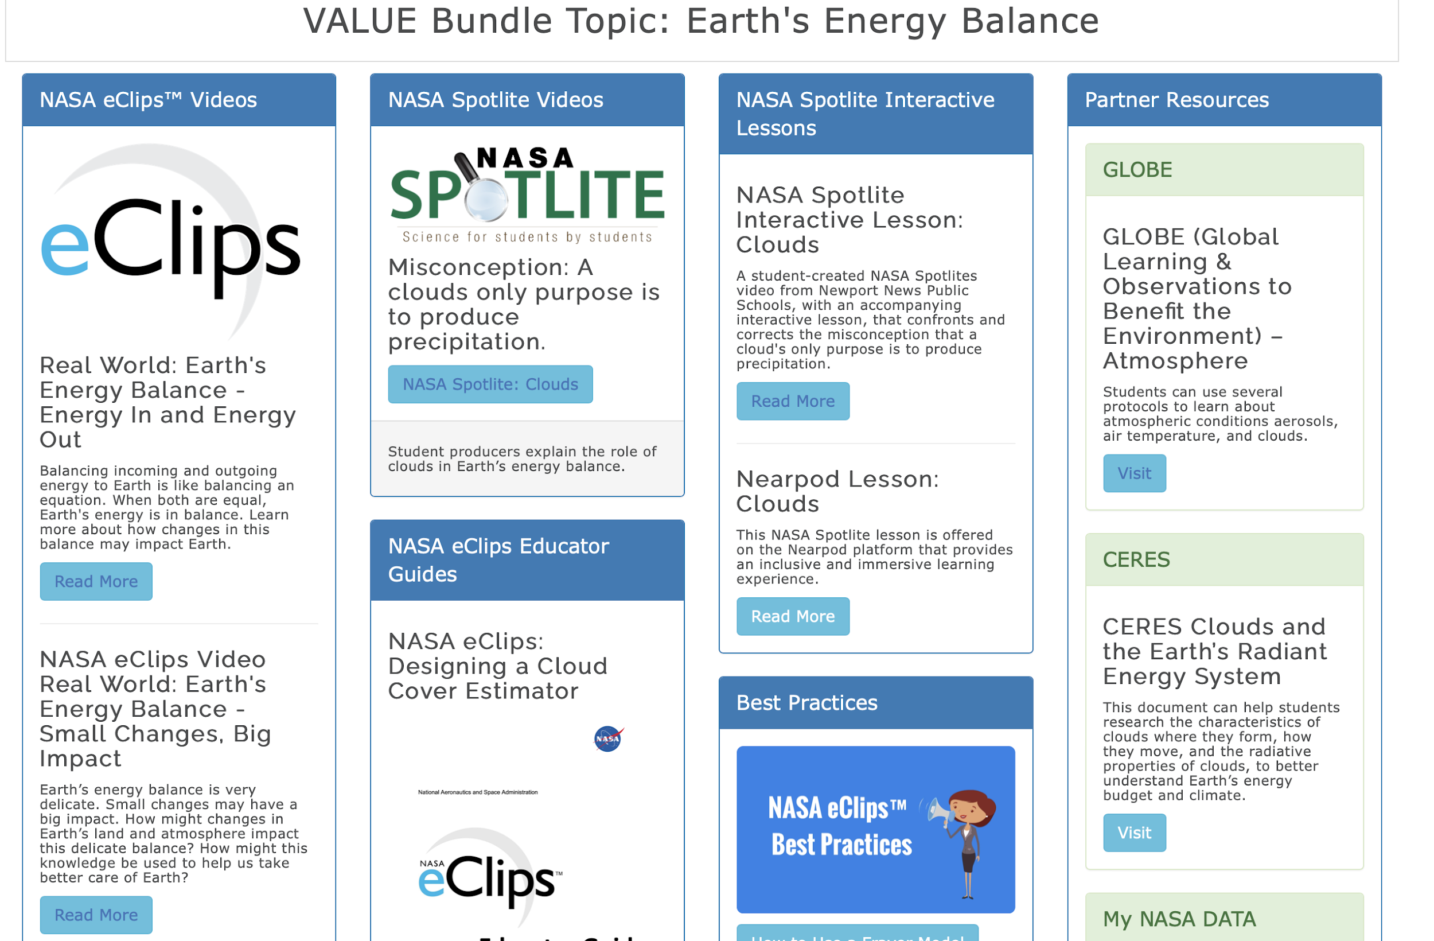
NASA eClips Thematic Units

Slide 10
Learn More at
https://nasaeclips.arc.nasa.gov/
Notes:
Joan
Throughout this training we will highlight and show how the NASA eClips resources can support your program.

Slide 11
NASA eClips is managed by the National Institute of Aerospace on behalf of NASA

